Slide 1
Convolutional Neural Networks

Slide 2
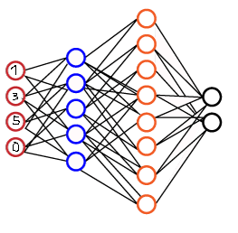
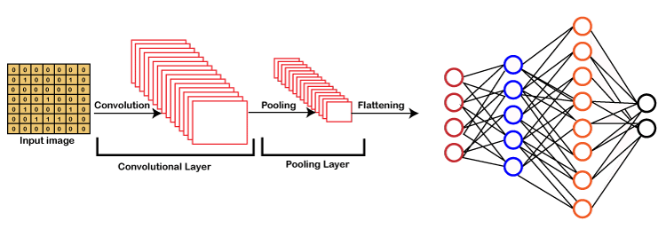
Find Difference
Regular NN
Convolutional NN

Slide 3
Find Difference
1. Input
Regular NN
Convolutional NN

Slide 4
Find Difference
1. Input
2. Convolutional layer
Regular NN
Convolutional NN

Slide 5
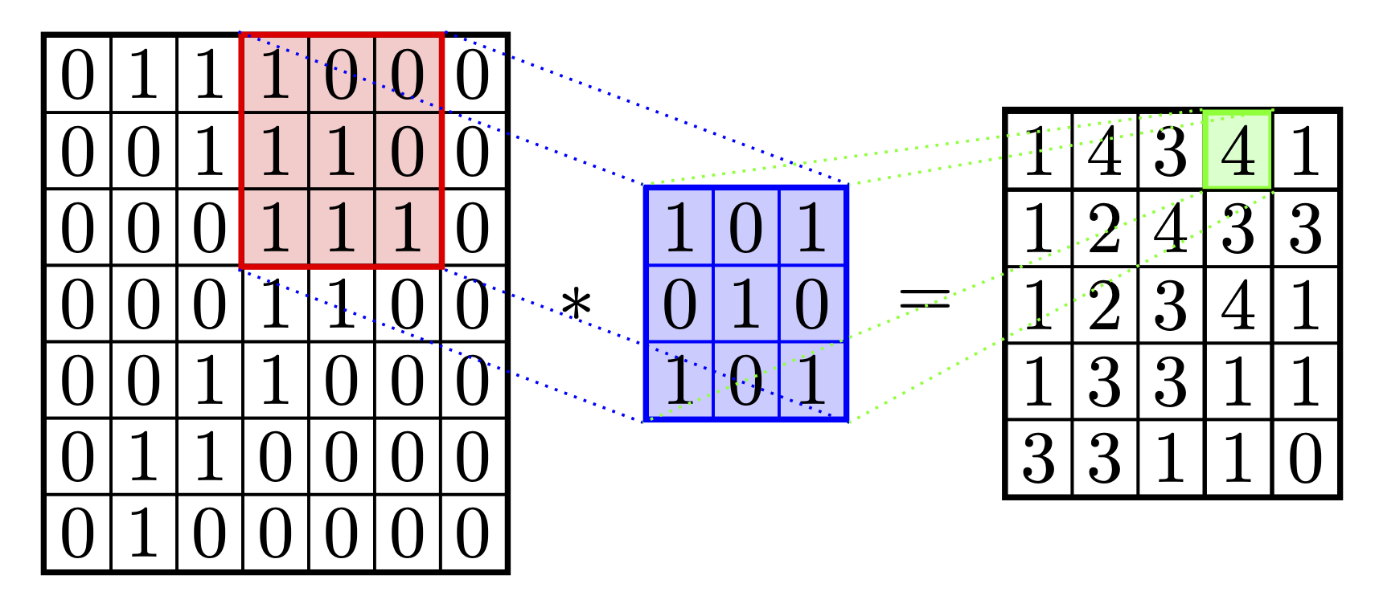
What is matrix convolution?
Small matrix (kernel) slighlty transforms (usually) huge matrix not changing its size.
Example:

Slide 6
Ok... But What it’s for?

Slide 7
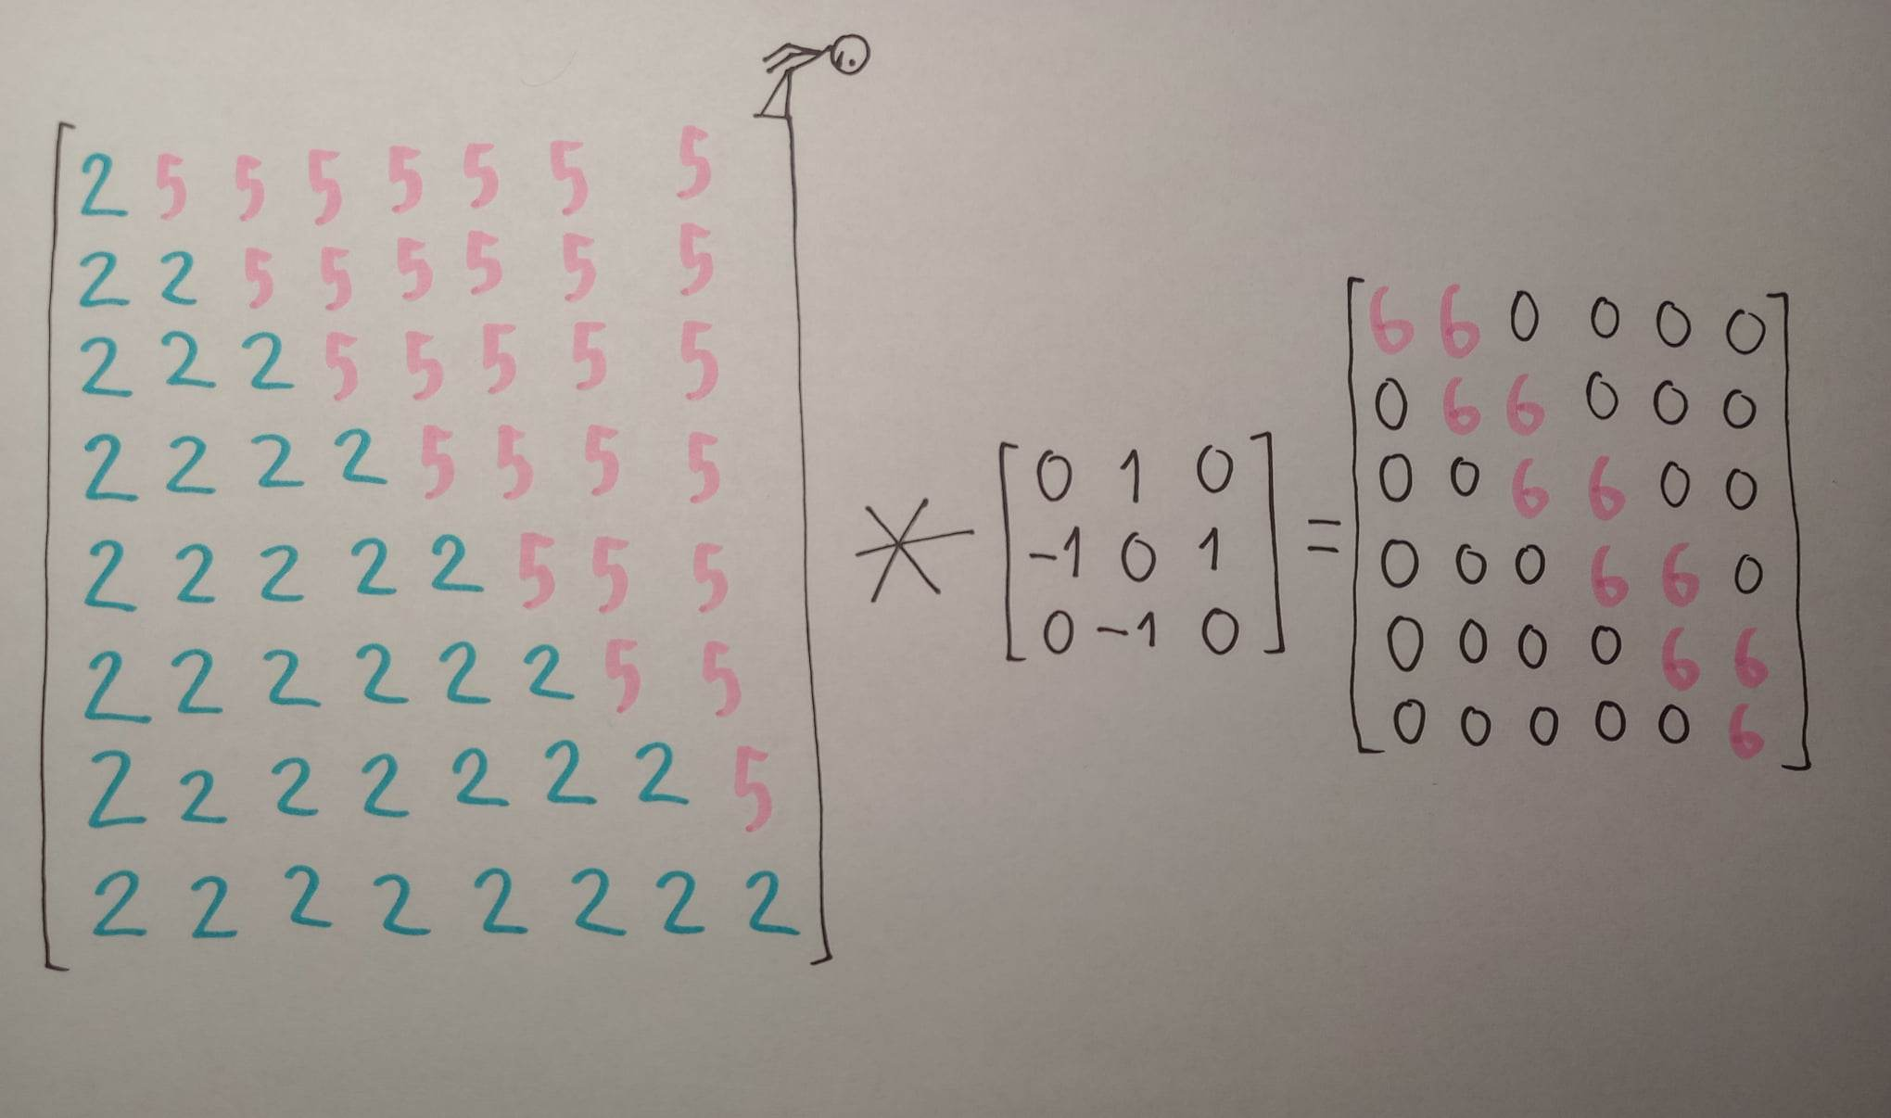
Edge detection!

Slide 8
Edge detection!
white – 1
grey – 0.5
black - 0
0.25 0 -0.25
0.50 0 -0.50
0.25 0 -0.25
kernel matrix
red – -1
blue – 1
black - 0
Credits to 3B1B

Slide 9
Convolution layer
Divide image into 3 channels (RGB)
Apply a convolution to each channel
At least 1 kernel per channel, sometimes up to 64
Fix things that break at borders of image
To each point of each channel you may apply sigmoids or RELU to avoid extreme values

Slide 10
Convolution layer
Problem 1: Huge size of file
Problem 2: Noise

Slide 11
Quick fix: pooling layer
AVERAGE POOLING – divide image into squares for example 3x3 and take the mean of values
MAXIMUM POOLING – again divide image into squares and use most extrem values
Both situations:
Size 9 times smaller
Noise reduced

Slide 12
Little left
Just flatten whole data you have:
[3 channels] x [kernels number] x [image width] x [image height]
and upload it to regular neural network.

Slide 13
Convolutional neural networks

